Slide 1

Business Analyst Career Program Capstone Project
Western Countries Financial Data

Slide 2
Financial Data
The total number of sales product in 2013 & 2014 Data Analysis
We can see Segment in Row Labels Channel Partners, Enterprise, Government and Small Business of total sales.
In above chart show the total sales and profit in financial years. Except Enterprise segment all are in profit but
Enterprise going loss in this year.
Conclusion - We Know the above chart, Enterprise segment running in loss. We need to improve this segment
sales in profit.

Slide 3
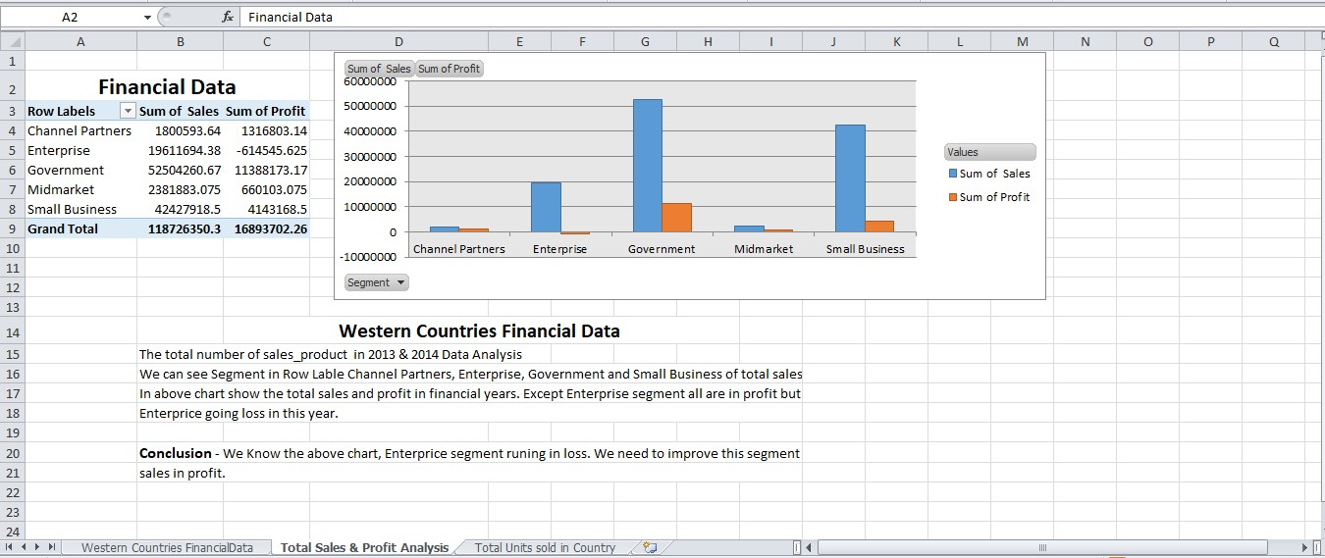

Slide 4
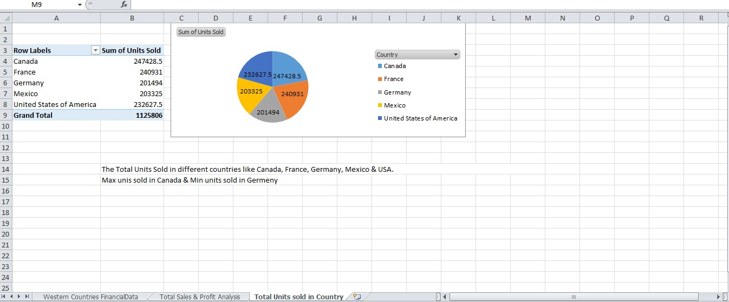

Slide 5
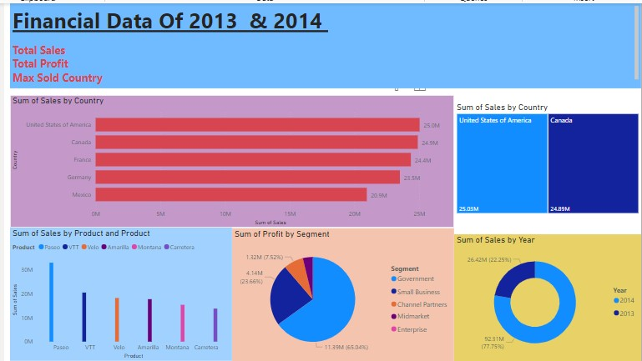

Slide 6
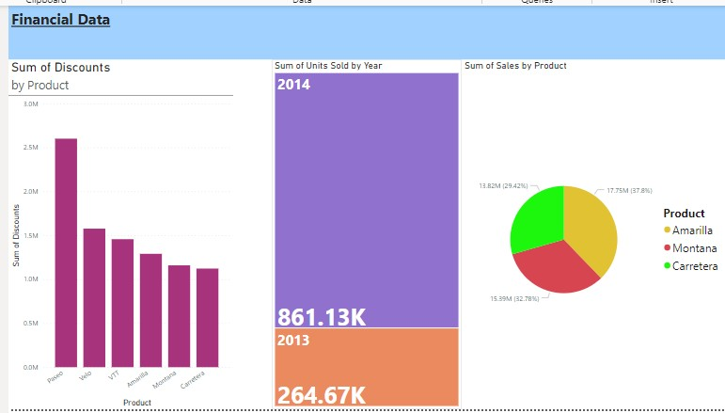

Slide 7
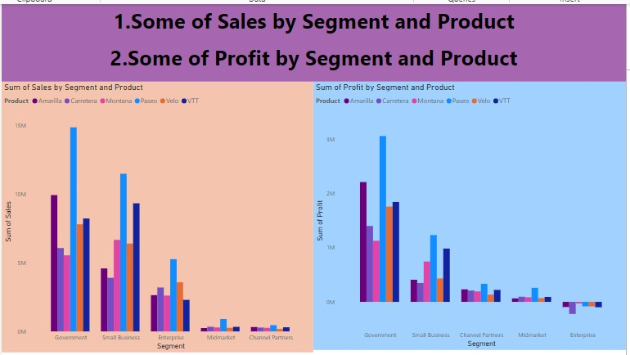

Slide 8
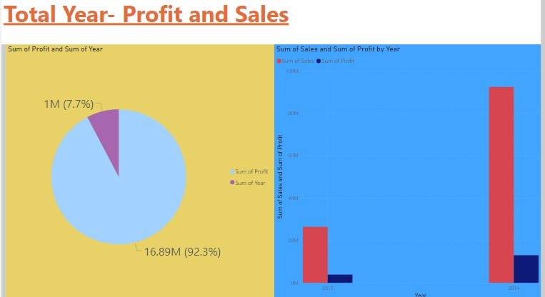

Slide 9
Conclusion
Western Countries Financial Data
The data shown sales and profit in financial year 2013-2014.
It is useful to measuring the activity of the business throw the chart where is maximum & minimum sales need to improve.
We use the Excel, SQL and Power BI then easy to understand the financial data.

